Slide 1

13 - Classes
TK1114 Computer Programming

Slide 2
Introduction
We've been using predefined classes.
Java class library : classes that comes packaged with Java Standard Edition. These are the foundation classes that can be used / extended to create an application.
e.g. String, Math, Scanner
extended classes
e.g. MTurtle & MGraphics

Slide 3
Writing Our Own Classes
Now we will begin to design programs that rely on classes that we write ourselves
The class that contains the main method is just the starting point of a program
True object-oriented programming is based on defining classes that represent objects with well-defined characteristics and functionality

Slide 4
Classes and Objects
Recall from our overview of objects in Topic 02 that an object has state and behavior
Consider a six-sided die (singular of dice)
It’s state can be defined as which face is showing
It’s primary behavior is that it can be rolled
We can represent a die in software by designing a class called Die that models this state and behavior
The class serves as the blueprint for a die object
We can then instantiate as many die objects as we need for any particular program

Slide 5
Classes
A class can contain data declarations and method declarations
int faceValue;
Attribute declarations
Method declarations

Slide 6
Classes
The values of the data define the state of an object created from the class
The functionality of the methods define the behaviors of the object
For our Die class, we might declare an integer that represents the current value showing on the face
One of the methods would “roll” the die by setting that value to a random number between one and six

Slide 7
Classes
We would like to design the Die class with other data and methods to make it a versatile and reusable resource
Any given program will not necessarily use all aspects of a given class
See RollingDie.java
See Die.java
© 2004 Pearson Addison-Wesley. All rights reserved

Slide 8
public class Die {
private final int MAX = 6; // maximum face value
private int faceValue; // current value showing on the die
// Constructor: Sets the initial face value.
public Die(){
faceValue = 1;
}
// Rolls the die and returns the result.
public int roll() {
faceValue = (int)(Math.random() * MAX) + 1;
return faceValue;
}

Slide 9
// Face value mutator.
public void setFaceValue (int value) {
faceValue = value;
}
// Face value accessor.
public int getFaceValue() {
return faceValue;
}
// Returns a string representation of this die.
public String toString() {
String result = Integer.toString(faceValue);
return result;
}
}
© 2004 Pearson Addison-Wesley. All rights reserved

Slide 10
public class RollingDie {
public static void main(String[] args) {
int N = 1000;
Die die = new Die();
int [] face = new int [7];
int x = 0;
for (int i = 0; i < N; i++) {
x = die.roll();
face[x]++;
}
for (int i = 1; i <= 6; i++)
System.out.println(i + ": " + face[i] + " " + (double)face[i]/N);
}
}

Slide 11
The Die Class
The Die class contains two attributes
a constant MAX that represents the maximum face value
an integer faceValue that represents the current face value
The roll method uses the random method of the Math class to determine a new face value
There are also methods to explicitly set and retrieve the current face value at any time

Slide 12
The toString Method
All classes that represent objects should define a toString method
The toString method returns a character string that represents the object in some way
It is called automatically when an object is concatenated to a string or when it is passed to the println method

Slide 13
Constructors
A constructor is a special method that is used to set up an object when it is initially created
A constructor has the same name as the class
The Die constructor is used to set the initial face value of each new die object to one
We examine constructors in more detail later.
© 2004 Pearson Addison-Wesley. All rights reserved

Slide 14
Data Scope
The scope of data is the area in a program in which that data can be referenced (used)
Data declared at the class level can be referenced by all methods in that class
Data declared within a method can be used only in that method
Data declared within a method is called local data
In the Die class, the variable result is declared inside the toString method -- it is local to that method and cannot be referenced anywhere else

Slide 15
Instance Data
The faceValue variable in the Die class is called instance data because each instance (object) that is created has its own version of it
A class declares the type of the data, but it does not reserve any memory space for it
Every time a Die object is created, a new faceValue variable is created as well
The objects of a class share the method definitions, but each object has its own data space
That's the only way two objects can have different states
© 2004 Pearson Addison-Wesley. All rights reserved

Slide 16
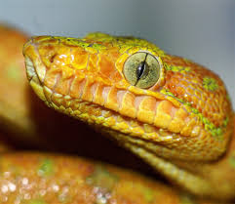

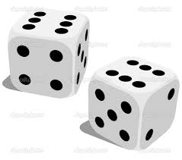
Example – Using the Die Class
Snake Eyes
How many times do you have to roll a pair of dice before they come up snake eyes?
Snake eyes means that both dice show a value of 1
Rolling Doubles
How many times do you have to roll a pair of dice until both dice have the same value
Do we need to declare new methods in the Die class?

Slide 17
public class SnakeEyes {
public static void main(String[] args) {
Die die1, die2;
int rollCount ;
int total;
die1 = new Die();
die2 = new Die();
rollCount = 0;
do {
die1.roll();
die2.roll();
System.out.println("Your roll is " +
die1.getFaceValue() + " " + die2.getFaceValue());
total = die1.getFaceValue() + die2.getFaceValue();
rollCount++;
} while (total != 2);
System.out.println("\nIt took " + rollCount + " rolls to get snake eyes");
}
}

Slide 18
Instance Data
We can depict the two Die objects from the SnakeEyes program as follows:
die1
faceValue
5
die2
faceValue
2
Each object maintains its own faceValue variable, and thus its own state

Slide 19
Dice rolling probability
What is the probability of rolling snake eyes?
What is the probability of rolling doubles?
http://www.math.hawaii.edu/~ramsey/Probability/TwoDice.html
Video: https://www.khanacademy.org/math/precalculus/prob_comb/independent_events_precalc/v/events-and-outcomes-2

Slide 20
UML Diagrams
UML stands for the Unified Modeling Language
UML diagrams show relationships among classes and objects
A UML class diagram consists of one or more classes, each with sections for the class name, attributes (data), and operations (methods)
Lines between classes represent associations
A dotted arrow shows that one class uses the other (calls its methods)

Slide 21
UML Class Diagrams
A UML class diagram for the SnakeEyes program:
SnakeEyes
Die
faceValue : int
main (args : String[]) : void
roll() : int
setFaceValue (int value) : void
getFaceValue() : int
toString() : String

Slide 22
Example : Car Class
Behaviour
turn right
turn left
brake
accelerate
Attributes
plate number
colour
made
year
Car
Plate number Color Made Year
turn right turn left brake accelerate

Slide 23
Example : Course Class
Attributes
course name
course code
number of students
lecturer name
Course
course name course code number of students lecturer name
???

Slide 24
Example : Circle Class
Behaviour
setRadius
getRadius
getArea
getCircumference
Attributes
radius
Circle
radius
setRadius getRadius getArea getCircumference

Slide 25
public class Circle {
private double radius; // private instance variable
public Circle() { // constructor without parameter
radius = 0.0;
}
void setRadius(double rad) {
radius = rad;
}
double getRadius() {
return radius;
}
double getArea() {
return radius * radius * Math.PI;
}
double getCircumference() {
return 2 * Math.PI * radius;
}
}

Slide 26
public class TestPC2Circle {
public static void main(String[] args) {
Scanner sc = new Scanner(System.in);
DecimalFormat df = new DecimalFormat("0.0000");
double radius, area, circumference;
int N = sc.nextInt();
for (int i = 1; i <= N; i++) {
Circle myCircle = new Circle(); // create Circle object
radius = sc.nextDouble();
myCircle.setRadius(radius); // sets radius
area = myCircle.getArea(); // returns area
circumference = myCircle.getCircumference(); // returns
System.out.println("Case #" + i + ": " +
df.format(myCircle.getRadius()) + " " +
df.format(area) + " " + df.format(circumference));
}
}
}

Slide 27
Exercise
Identify the attributes (at least: 2 static + 3 dynamic ) and behaviour (4) for the following classes
1. Cat
2. Movie
3. Student
4. Bicycle
5. Book
6. Comic
7. Hotel Room
8. Door

Slide 28
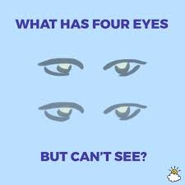
Example : Riddle Class
public class Riddle {
private String question;
private String answer;
public Riddle(String q, String a) {
question = q;
answer = a;
}
public String getQuestion() {
return question;
}
public String getAnswer() {
return answer;
}
}
Riddle
question answer
Riddle(String q, String a) getQuestion():String getQuestion():String getAnswer():String

Slide 29
public class RiddleApplication {
public static void main(String [] args) {
Riddle riddle1 = new Riddle(
"What is black and white and red all over?",
"An embarrassed zebra.");
Riddle riddle2 = new Riddle(
"What is black and white and read all over?",
"A newspaper.");
System.out.println("Here are two riddles:");
System.out.println(riddle1.getQuestion());
System.out.println(riddle2.getQuestion());
System.out.println("The answer to the first riddle is:");
System.out.println(riddle1.getAnswer());
System.out.println("The answer to the second is:");
System.out.println(riddle2.getAnswer());
}
}

Slide 30
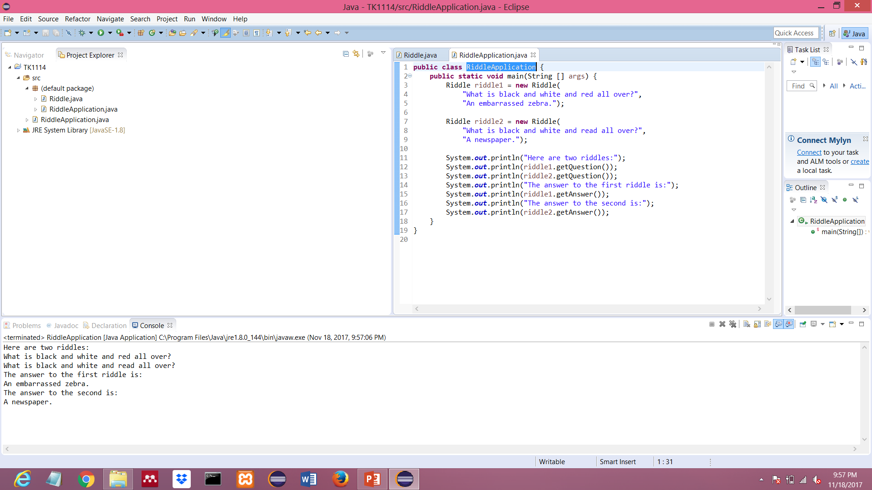

Slide 31
Modify RiddleApplication.java such that the program waits for the user to answer the riddle and respond appropriately.
User are given two chances to answer correctly

Slide 32
Example : Contact Class
Attribute
name
phone number
address
email
Methods
setter & getter methods
…
Contact
name phone number address email
setName(String name):void getName():int setPhone(String phone):void getPhone():Address

Slide 33
public class Contact{
private String name;
private String phoneNumber;
// other attributes...
public Contact(String name, String phone){
setName(name);
setAddress(address);
}
public void setName(String name){ // mutator methods (setter)
this.name = name;
}
public int getName(){ // accessor methods (getter)
return month;
}
public void setPhone(String phone){ // mutator methods (setter)
this.phoneNumber = phone;
}
public Address getPhone(){
return phoneNumber;
}
}

Slide 34
Example : TicTacToe Class
TicTacToe
private char[][] board; private char currentPlayerMark;
public TicTacToe() // constructor --- to initialize the board public void printBoard() public boolean isBoardFull() public boolean checkForWin() public void changePlayer() public boolean placeMark(int row, int col)
http://www.coderslexicon.com/a-beginner-tic-tac-toe-class-for-java/
Complete the game program

Slide 35
Encapsulation
We can take one of two views of an object:
internal - the details of the variables and methods of the class that defines it
external - the services that an object provides and how the object interacts with the rest of the system
From the external view, an object is an encapsulated entity, providing a set of specific services
These services define the interface to the object

Slide 36
Encapsulation
One object (called the client) may use another object for the services it provides
The client of an object may request its services (call its methods), but it should not have to be aware of how those services are accomplished
Any changes to the object's state (its variables) should be made by that object's methods
We should make it difficult, if not impossible, for a client to access an object’s variables directly
That is, an object should be self-governing

Slide 37
Encapsulation
An encapsulated object can be thought of as a black box -- its inner workings are hidden from the client
The client invokes the interface methods of the object, which manages the instance data
Client
Methods
Data
To achieve encapsulation in Java −
Declare the variables of a class as private.
Provide public setter and getter methods to modify and view the variables values.

Slide 38
Visibility Modifiers
In Java, we accomplish encapsulation through the appropriate use of visibility modifiers
A modifier is a Java reserved word that specifies particular characteristics of a method or data
We've used the final modifier to define constants
Java has three visibility modifiers: public, protected, and private
The protected modifier involves inheritance, which we will discuss later

Slide 39
Visibility Modifiers
Members of a class that are declared with public visibility can be referenced anywhere
Members of a class that are declared with private visibility can be referenced only within that class
Members declared without a visibility modifier have default visibility and can be referenced by any class in the same package

Slide 40
Visibility Modifiers
Public variables violate encapsulation because they allow the client to “reach in” and modify the values directly
Therefore instance variables should not be declared with public visibility
It is acceptable to give a constant public visibility, which allows it to be used outside of the class
Public constants do not violate encapsulation because, although the client can access it, its value cannot be changed

Slide 41
Visibility Modifiers
Methods that provide the object's services are declared with public visibility so that they can be invoked by clients
Public methods are also called service methods
A method created simply to assist a service method is called a support method
Since a support method is not intended to be called by a client, it should not be declared with public visibility

Slide 42
Visibility Modifiers
public
private
Violate
encapsulation
Enforce
encapsulation
Variables
Service methods
Support
methods
Methods

Slide 43
Accessors and Mutators
Because instance data is private, a class usually provides services to access and modify data values
An accessor method returns the current value of a variable
A mutator method changes the value of a variable
The names of accessor and mutator methods take the form getX and setX, respectively, where X is the name of the value
They are sometimes called “getters” and “setters”

Slide 44
Mutator Restrictions
The use of mutators gives the class designer the ability to restrict a client’s options to modify an object’s state
A mutator is often designed so that the values of variables can be set only within particular limits
For example, the setFaceValue mutator of the Die class should have restricted the value to the valid range (1 to MAX)

Slide 45
Method Control Flow
If the called method is in the same class, only the method name is needed
compute
myMethod
myMethod();

Slide 46
Method Control Flow
The called method is often part of another class or object
main
doIt
helpMe
obj.doIt();
helpMe();

Slide 47
Method Header
A method declaration begins with a method header
char calc (int num1, int num2, String message)
method
name
parameter list
return
type
The parameter list specifies the type and name of each parameter
The name of a parameter in the method declaration is called a formal parameter

Slide 48
Method Body
The method header is followed by the method body
char calc (int num1, int num2, String message) {
int sum = num1 + num2;
char result = message.charAt (sum);
return result;
}
sum and result are local data
They are created each time the method is called, and are destroyed when it finishes executing
The return expression
must be consistent with
the return type

Slide 49
The return Statement
The return type of a method indicates the type of value that the method sends back to the calling location
A method that does not return a value has a void return type
A return statement specifies the value that will be returned
return expression;
Its expression must conform to the return type

Slide 50
Parameters
When a method is called, the actual parameters in the invocation are copied into the formal parameters in the method header
ch = obj.calc (25, count, "Hello");
char calc (int num1, int num2, String message) {
int sum = num1 + num2;
char result = message.charAt (sum);
return result;
}

Slide 51
Local Data
As we’ve seen, local variables can be declared inside a method
The formal parameters of a method create automatic local variables when the method is invoked
When the method finishes, all local variables are destroyed (including the formal parameters)
Keep in mind that instance variables, declared at the class level, exists as long as the object exists

Slide 52
Exercise
Design and implement a class called Box that contains instance data that represents the height, width, and depth of the box. Also include a boolean variable called full as instance data that represents if the box is full or not.
Define three Box constructors
no arguments and creates the unit box
one argument and creates a cube of that size
three arguments to accept and initialize the height, width, and depth of the box in that order
Each newly created Box is empty (the constructor should initialize full to false).
Other methods
Include a toString method that returns a one-line description of the box.
Include accessors (getter) and mutators (setter) methods for all instance data.
Include calculation of the volume of the box

